Slide 1

Daily Review
Reminder:
GPE = m x g x h g = 9.8 m/s² KE = ½ m x v²
Calculating Values Related to Potential and Kinetic Energy
Write down the information you are given. Choose an equation to used based on the information given and rearrange the equation to find your unknown. Substitute values into the equation and solve. Add appropriate units
A 1 kg book is placed on a shelf 2 m from the ground. What is its gravitational potential energy?
1. GPE = ?
h = 1.5 m
m = 1 kg
g = 9.8 m/s²
2. GPE = m x g x h
3. GPE = 1 x 9.8 x 2
GPE = 19.6
4. The book has 19.6 J of gravitational potential energy.

Slide 2
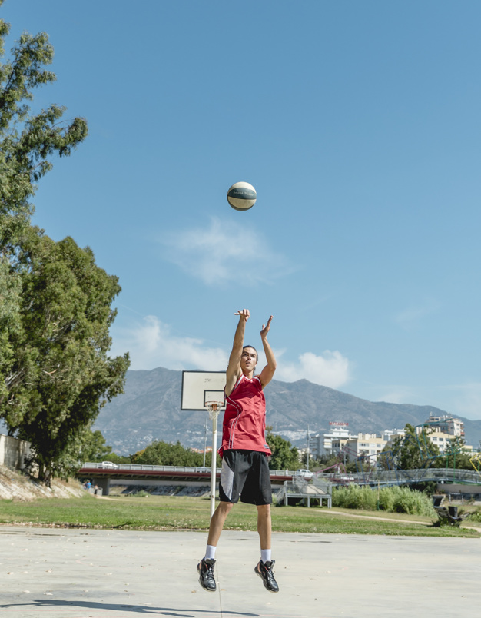
Daily Review
Reminder:
GPE = m x g x h g = 9.8 m/s² KE = ½ m x v²
Calculating Values Related to Potential and Kinetic Energy
Write down the information you are given. Choose an equation to used based on the information given and rearrange the equation to find your unknown. Substitute values into the equation and solve. Add appropriate units
An object is thrown into the air at a velocity of 10 m/s. If its mass is 2 kg, how much kinetic energy does it have when it leaves the person’s hand?
1. KE = ?
v = 10 m/s
m = 2 kg
2. KE = ½m x v²
3. KE = ½ x 2 x 10²
KE = ½ x 2 x 100
KE = 1 x 100
KE = 100
4. The object has 100 J of kinetic energy when it leaves the person’s hand.

Slide 3
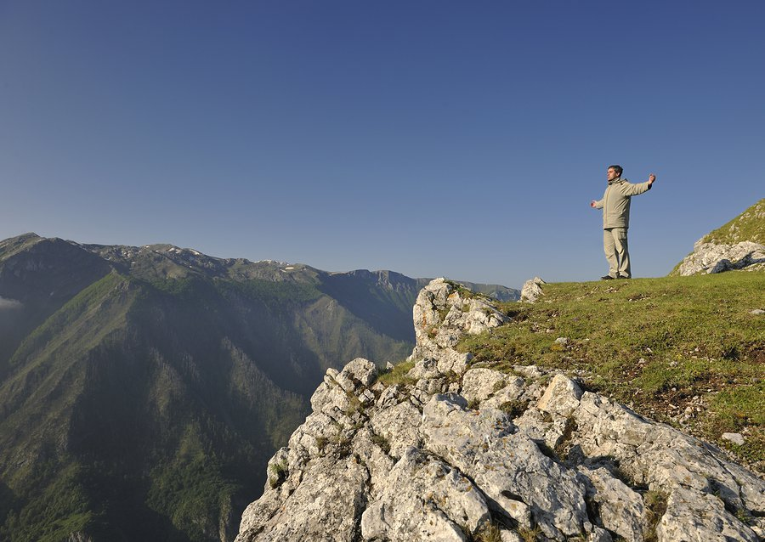
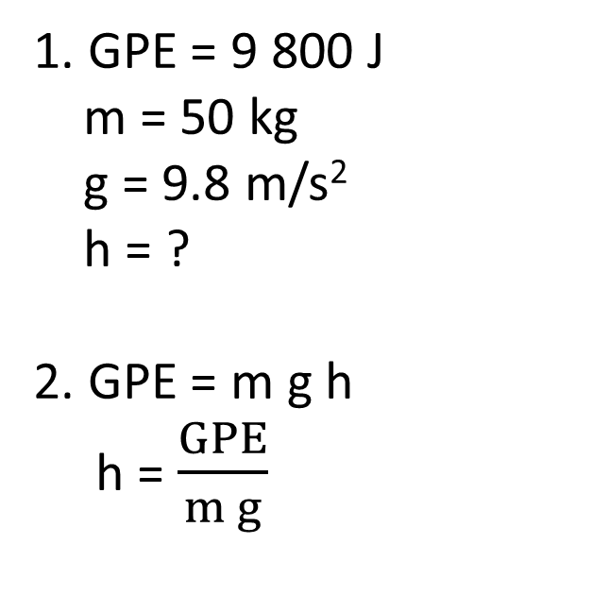
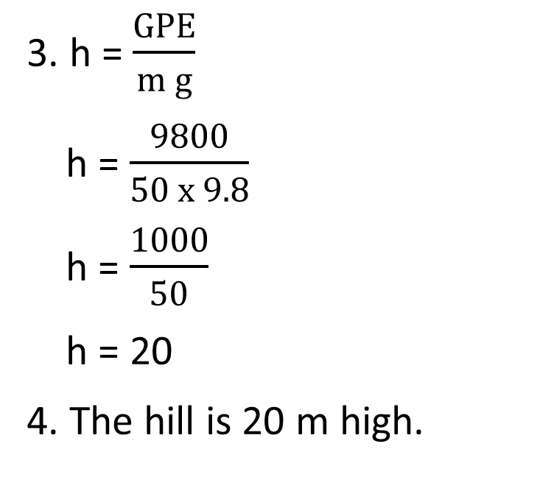
Daily Review
Reminder:
GPE = m x g x h g = 9.8 m/s² KE = ½ m x v²
Calculating Values Related to Potential and Kinetic Energy
Write down the information you are given. Choose an equation to used based on the information given and rearrange the equation to find your unknown. Substitute values into the equation and solve. Add appropriate units
You are standing on the top of a hill. Your gravitational potential energy is 9800 J and you have a mass of 50 kg. What is the height of the hill?
1. GPE = 9 800 J
m = 50 kg
g = 9.8 m/s²
h = ?
2. GPE = m g h
h = $\frac{GPE}{m g}$
3. h = $\frac{GPE}{m g}$
h = $\frac{9800}{50 x 9.8}$
h = $\frac{1000}{50}$
h = 20
4. The hill is 20 m high.

Slide 4
Potential and Kinetic Energy Calculations Part 2 Year 10 Physics

Slide 5
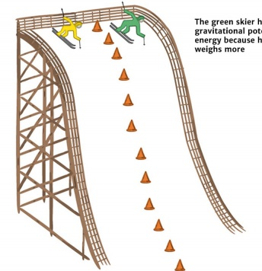
Learning Objectives
CFU
What are we going to learn?
Calculate the gravitational potential energy and kinetic energy in objects.
Activate Prior Knowledge
70 kg
90 kg
The gravitational potential energy is related to its mass and its height. This can be represented using the equation: GPE = mgh.
Calculate the potential energy of each of the skiers in the picture, if the hill has a height of 20 m.
Think, pair, share: Which skier will be travelling faster at the bottom of the hill? Why?

Slide 6

Concept Development
CFU 1
What is the Law of Conservation of Energy?
Law of Conservation of Energy
Energy is always conserved: it cannot be created or destroyed, it can only be transferred or transformed.
This means that in every energy transformation, the total energy before the transformation is equal to the total energy after the transformation.
Let’s say that your phone battery can hold 2500 J of chemical energy. If you could measure the amount of light, sound, kinetic and heat energy the phone produced from that charge, it would all add up to 2500 J.
CFU 2
A light bulb converts electrical energy into light and heat. If 80 J of light and 20 J of heat is produced, how much energy was used by the light bulb?

Slide 7
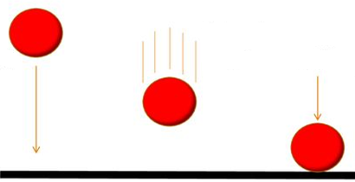
Concept Development
CFU 1
How does the Law of Conservation of Energy apply to falling objects?
Law of Conservation of Energy in Falling Objects
When an object falls, its gravitational potential energy before it is dropped is equal to its kinetic energy when it reaches the ground.
The gravitational potential energy is transformed into kinetic energy as it falls.
At any point in the object’s fall: Energy_{total =} GPE + KE
CFU 2
Halfway to the ground, the ball has 50 J of gravitational potential energy. What is its kinetic energy at this point in its fall?
GPE = 50 J
KE = ? J
E_{total} = 100 J
Reminder: Law of Conservation of Energy
Energy cannot be created or destroyed, only transferred or transformed.
GPE = 100 J
KE = 0 J
E_{total} = 100 J
GPE = 0 J
KE = 100 J
E_{total} = 100 J

Slide 8
Skill Development/Guided Practice
Reminder:
GPE = m x g x h g = 9.8 m/s² KE = ½ m x v² E_{total} = GPE + KE
Multi-Step Problems
Write down the information you are given. Choose an equation to used based on the information given and rearrange the equation to find your unknown. Substitute values into the equation and solve. Add appropriate units
A 0.5 kg book is sitting on a shelf 2 m from the ground. If it falls, what would be its kinetic energy when it reaches the ground?
1. KE = ? = GPE
m = 0.5 kg
h = 2 m
g = 9.8 m/s²
2. GPE = mgh
3. GPE = m g h
GPE = 0.5 x 9.8 x 2
GPE = 9.8 J
4. The book has 9.8 J of kinetic energy.
The kinetic energy of the book when it reaches the floor is equal to its gravitational potential energy on the shelf.

Slide 9
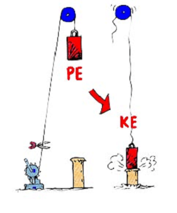
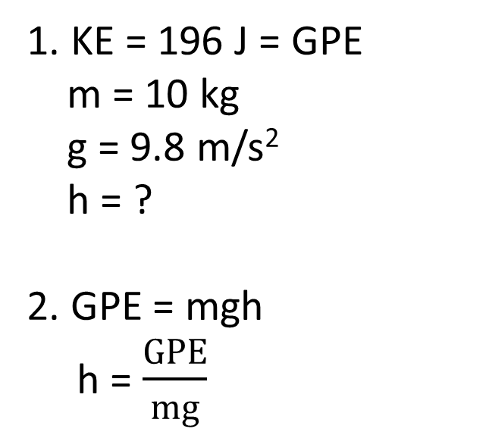
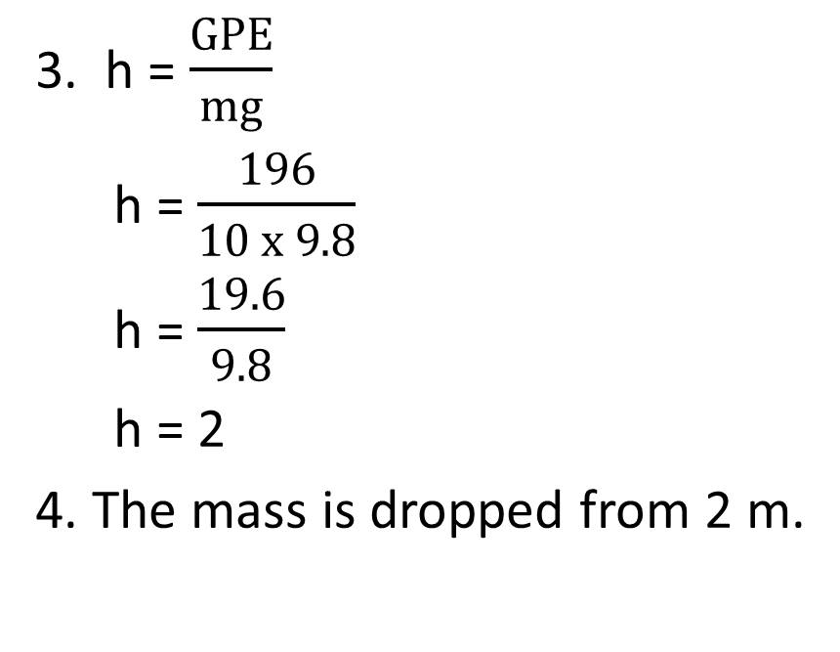
Skill Development/Guided Practice
Reminder:
GPE = m x g x h g = 9.8 m/s² KE = ½ m x v²
Multi-Step Problems
Write down the information you are given. Choose an equation to used based on the information given and rearrange the equation to find your unknown. Substitute values into the equation and solve. Add appropriate units
A 10 kg mass is dropped from a height. It has 196 J of kinetic energy when it reaches the ground. From what height is it dropped?
1. KE = 196 J = GPE
m = 10 kg
g = 9.8 m/s²
h = ?
2. GPE = mgh
h = $\frac{GPE}{mg}$
3. h = $\frac{GPE}{mg}$
h = $\frac{196}{10 x 9.8}$
h = $\frac{19.6}{9.8}$
h = 2
4. The mass is dropped from 2 m.

Slide 10
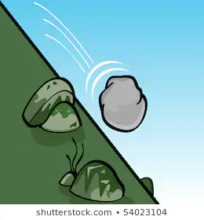
Skill Development/Guided Practice
Reminder:
GPE = m x g x h g = 9.8 m/s² KE = ½ m x v²
Multi-Step Problems
Write down the information you are given. Choose an equation to used based on the information given and rearrange the equation to find your unknown. Substitute values into the equation and solve. Add appropriate units
A rock with a mass of 8 kg rolls down a hill. At the bottom of the hill it has a velocity of 5 m/s. How much gravitational potential energy did it have at the top of the hill?
1. GPE = ? = KE
v = 5 m/s
m = 8 kg
2. KE = ½mv²
3. KE = ½mv²
KE = ½ x 8 x 5²
KE = ½ x 8 x 25
KE = 4 x 25
KE = 100 J
4. The rock has 100 J of gravitational potential energy.
The gravitational potential energy of the rock at the top of the hill is equal to its kinetic energy at the bottom.

Slide 11
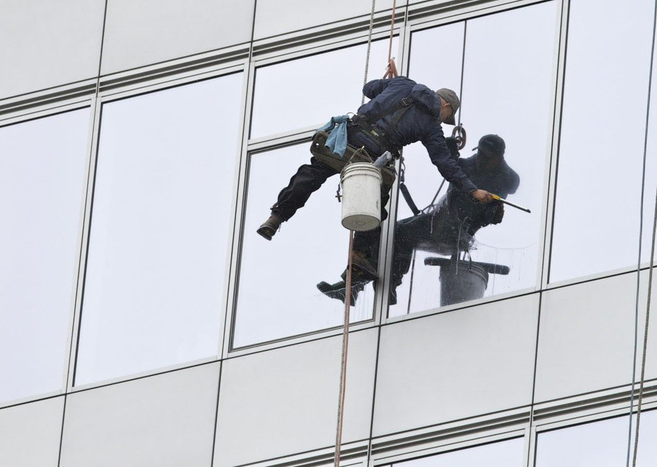
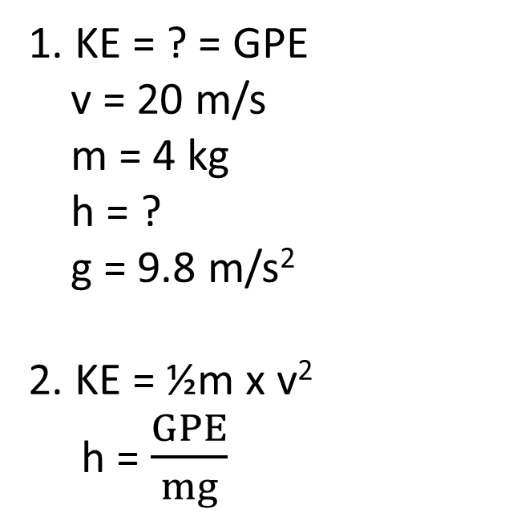
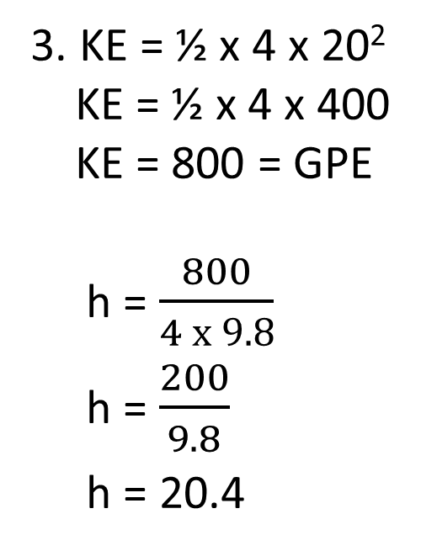
Skill Development/Guided Practice
Reminder:
GPE = m x g x h g = 9.8 m/s² KE = ½ m x v²
Multi-Step Problems
Write down the information you are given. Choose an equation to used based on the information given and rearrange the equation to find your unknown. Substitute values into the equation and solve. Add appropriate units
A window cleaner drops an object with a mass of 4 kg. Its velocity when it hits the ground is 20 m/s. What was the height of the window? (Hint: find the object’s kinetic energy first)
1. KE = ? = GPE
v = 20 m/s
m = 4 kg
h = ?
g = 9.8 m/s²
2. KE = ½m x v²
h = $\frac{GPE}{mg}$
3. KE = ½ x 4 x 20²
KE = ½ x 4 x 400
KE = 800 = GPE
h = $\frac{800}{4 x 9.8}$
h = $\frac{200}{9.8}$
h = 20.4
4. The height of the window is 20.4 m above the ground.

Slide 12
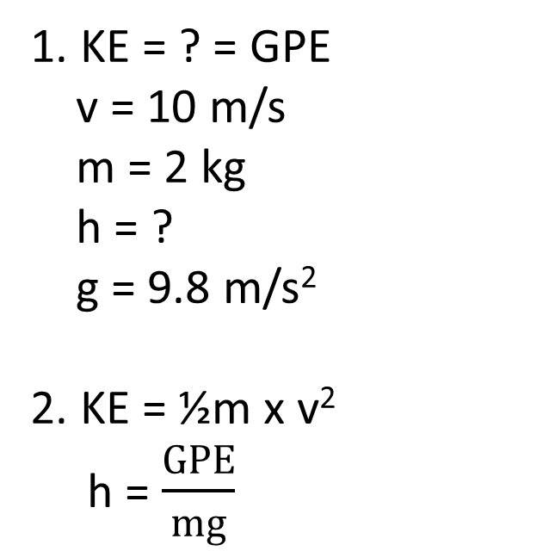
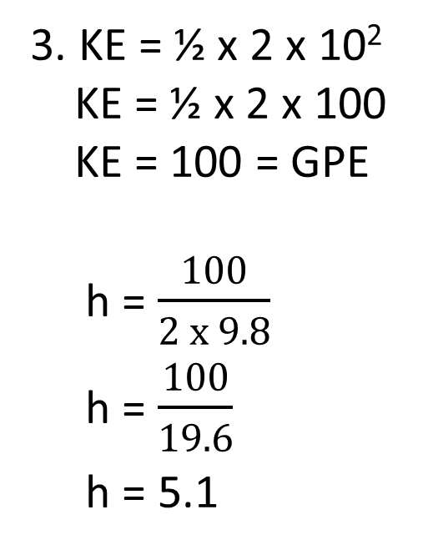
Skill Development/Guided Practice
Reminder:
GPE = m x g x h g = 9.8 m/s² KE = ½ m x v²
Multi-Step Problems
Write down the information you are given. Choose an equation to used based on the information given and rearrange the equation to find your unknown. Substitute values into the equation and solve. Add appropriate units
An object with a mass of 2 kg is thrown into the air at an initial velocity of 10 m/s. What will be the ball’s maximum height? (Hint: find the ball’s kinetic energy first)
1. KE = ? = GPE
v = 10 m/s
m = 2 kg
h = ?
g = 9.8 m/s²
2. KE = ½m x v²
h = $\frac{GPE}{mg}$
3. KE = ½ x 2 x 10²
KE = ½ x 2 x 100
KE = 100 = GPE
h = $\frac{100}{2 x 9.8}$
h = $\frac{100}{19.6}$
h = 5.1
4. The object will reach a height of 5.1 m above the person’s hand.

Slide 13
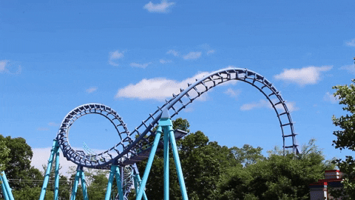
Relevance
Understanding the relationship between gravitational potential energy and kinetic energy will help you explain energy transformations in falling objects.
It will also help you explain why the velocity of objects increases as they fall or roll down a hill, as they lose gravitational potential energy and gain kinetic energy.

Slide 14
Skill Closure
Explain the Law of Conservation of Energy.
Skill Closure
Write the equations used to calculate the gravitational potential energy and the kinetic energy of an object.
Reminder:
GPE = m x g x h g = 9.8 m/s² KE = ½ m x v²
Skill Closure
A box with a mass of 4 kg is placed on a coffee table that is 1 m high. If the box fell, how much kinetic energy will the box have when it reaches the ground?

Slide 15
Independent Practice
Complete the GPE and KE calculations worksheet on your device or a paper copy.

